Slide 1
Lect 1
Software Security
Software Flaws
Buffer Overflow
Mrs. Arti Deshpande
TSEC

Slide 2

In this Section
Programming errors with security implications
Malicious Code
Program Development and Controls
Controls to protect against flaws in execution
Programs (lots of them)have errors
  How do we keep programs from flaws?
  How do we protect computing resources against programs that contain flaws?

Slide 3
Secure Programs
What is a secure program?
Everyone has there own requirement of secure.
Part of assessing software quality
Does it meet security requirements in specification? (is requirements complete?)
In general, we often look at quantity and types of faults for evidence of security (or lack of it). We track these things.

Slide 4
Who’s Fault is it?
Finding lots of faults in software early.
  NOT GOOD.
Early approaches were “Penetrate” and then “Patch”
  NOT GOOD.
Repairing with a patch is a narrow focus and not the more important requirements.
Patches can cause other problems.
  Non obvious side effects
  Fix one places – fails another
  Performance or function suffers

Slide 5
Types of Flaws
Validation error (incomplete or inconsistent): permissions checks
Domain error: controlled access to data
Serialization and aliasing: program flow order
Inadequate identification and authentication: basis for authorization
Boundary condition violation: failure on first or last case
Other exploitable logic errors

Slide 6
Unexpected Behavior
Unexpected behavior is a program security flaw.
Does the program behave as it was designed?
Behavior can be:
  Vulnerability (class of fault)
  Flaw (fault or failure)
Flaw (human)
  Inadvertent
  Intentional

Slide 7
Nonmalicious Program Errors
Buffer Overflows
  Excess information provided – overfilling the bucket
  Buffer – space in which data is held (array or string)
  char sample[10] or char sample[i]
  For (i=0; I<=9; i++)
  sample[i] = ‘A’;
  sample[10] = ‘B’;

Slide 8
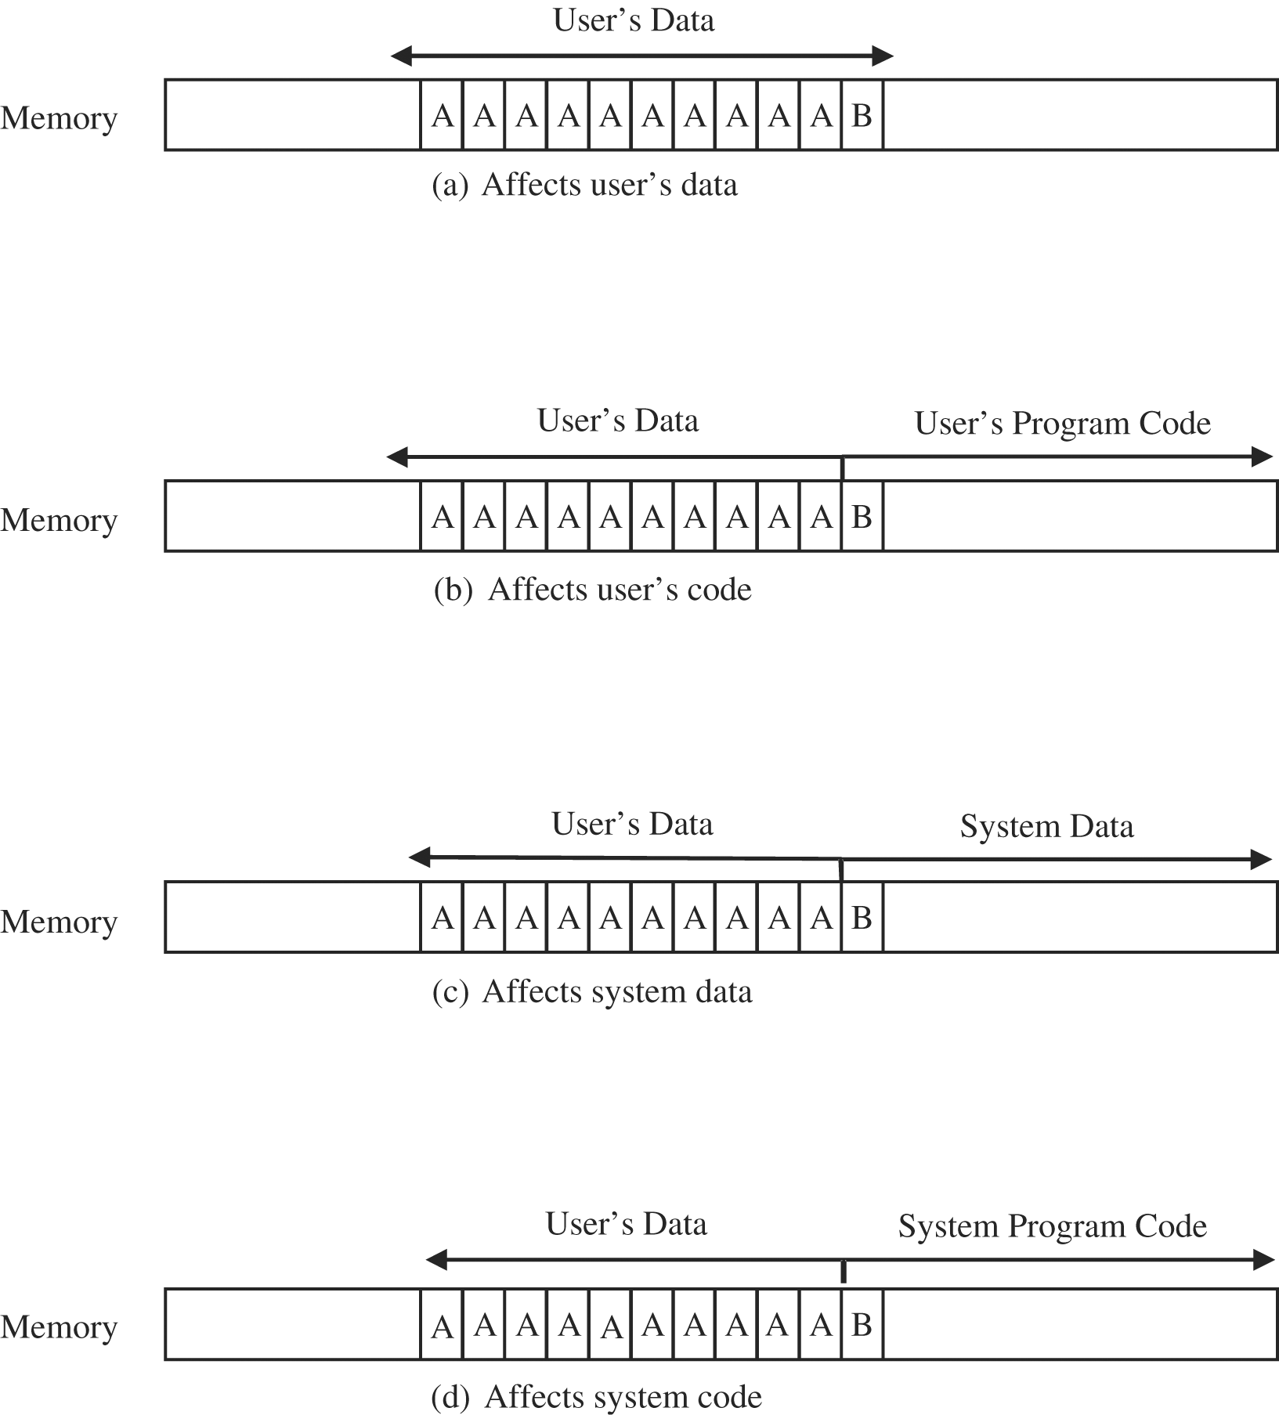
Figure 3-1 Places Where a Buffer Can Overflow.

Slide 9
Buffer overflows
One of the most common vulnerabilities in software
Particularly problematic when present in system libraries and other code that runs with high execution privileges.

Slide 10
How it works
Application reserves adjacent memory locations (buffer) to store arguments to a function, or variable values.
Attacker gives an argument too long to fit in the buffer.
The application copies the whole argument, overflowing the buffer and overwriting memory space.
If the conditions are “just right” this will enable to attacker to gain control over the program flow and execute arbitrary code, with the same privileges of the original application.

Slide 11
Buffer Overflows
void function(char *str) {
char buffer[8];
strcpy(buffer,str); }
void main() {
char large_string[256];
int i;
for( i = 0; i < 255; i++)
large_string[i] = 'A'; function(large_string); }

Slide 12
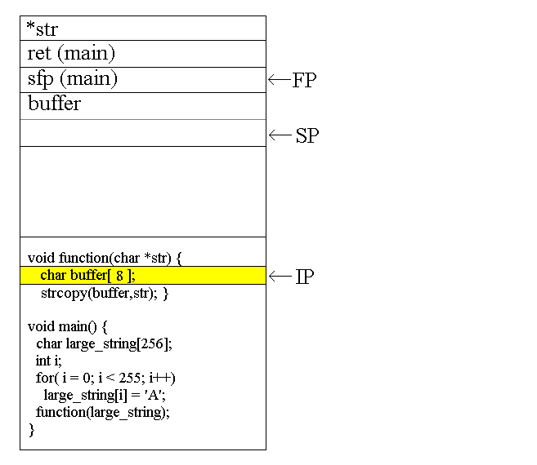
Buffer Overflows

Slide 13
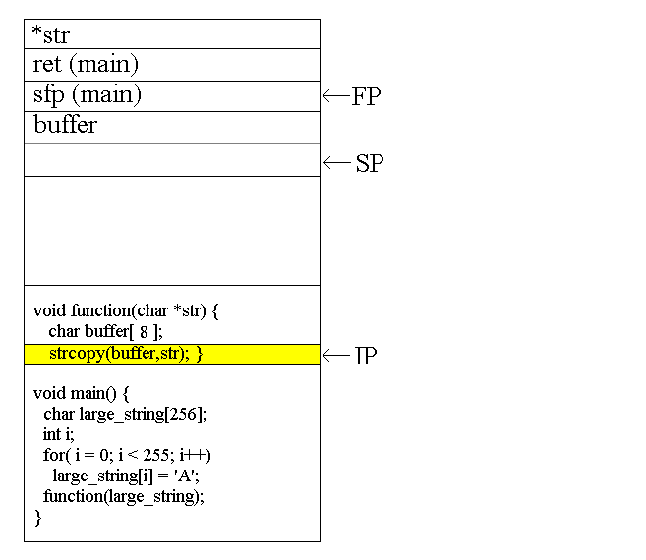
Buffer Overflows

Slide 14
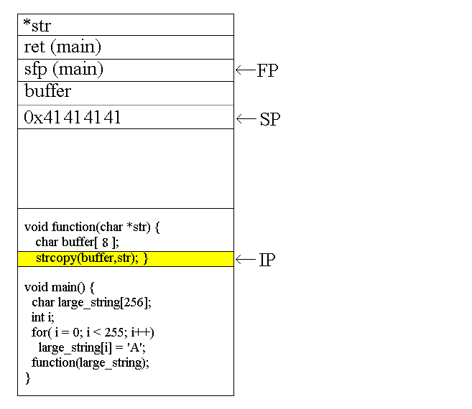
Buffer Overflows

Slide 15

Buffer Overflows

Slide 16
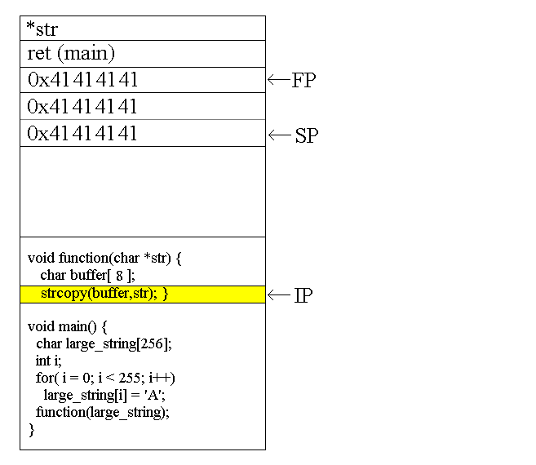
Buffer Overflows

Slide 17
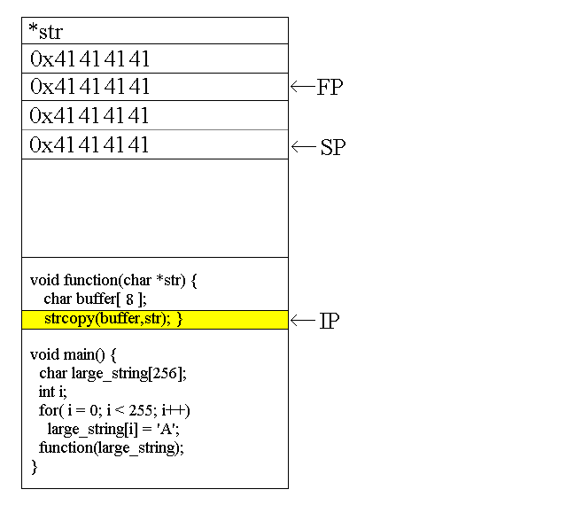
Buffer Overflows

Slide 18
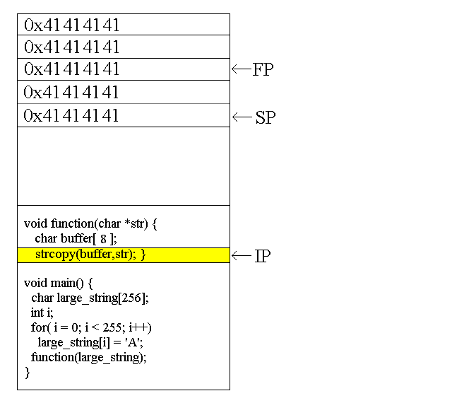
Buffer Overflows

Slide 19
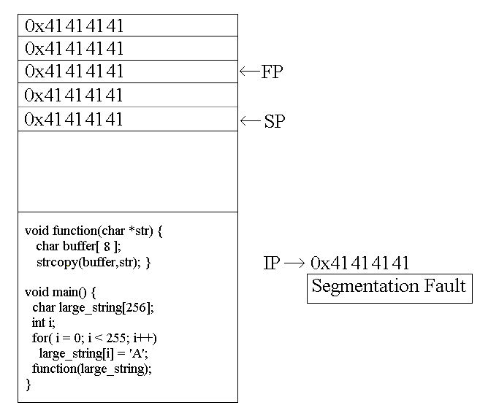
Buffer Overflows

Slide 20
Buffer Overflow Defenses
This presents some examples, pros, and cons of various defenses against buffer overflows.
Caveats:
  1. This is not intended to be a complete list of products that defend against buffer overflows.
  2. There is no silver bullet that will stamp out buffer overflows, but some of these tools may help.

Slide 21
Kinds of Defenses
Better software engineering practices
Find-and-patch methods
Language tools
Analysis tools
Compiler tools
Operating system tools

